Slide 1
House-Hold Rental Team-Alpha Project Review 3: Backend Presentations CPSC 5240-01 Software as a Service By, Amogha Lavanya Sravya
An e-commerce website which provides a platform for renting household goods, electronics, fashion items, furniture, art-painting, cars, bikes etc.

Slide 2
Technology Used
Front-end : HTML, JavaScript, JQuery
Bootstrap CSS
Middleware : MVC Java Spring (service Layer)
Backend : MongoDb
Tool used : Eclipse, Robo3T

Slide 3
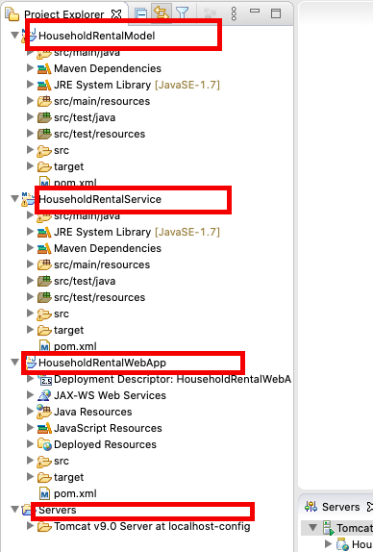
Code Organization
MVC Layer –
HouseholdRentalWebApp – Controllers and View
HouseholdRentalService – Service layer
HouseholdRentalModel – Model and Data layer

Slide 4
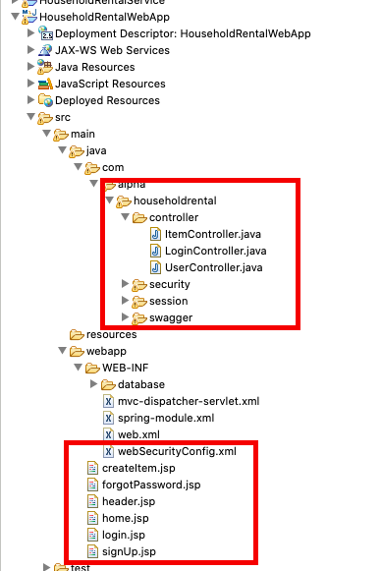
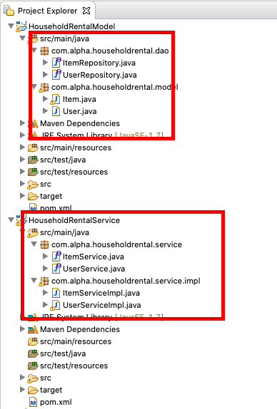

Slide 5
Code snippets - Controller

Slide 6
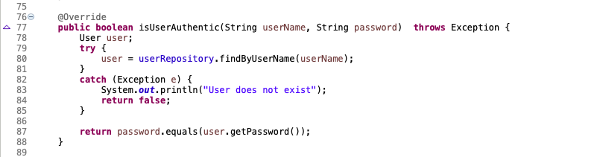
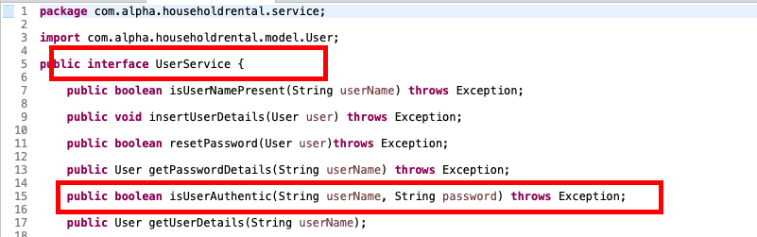
Service layer

Slide 7
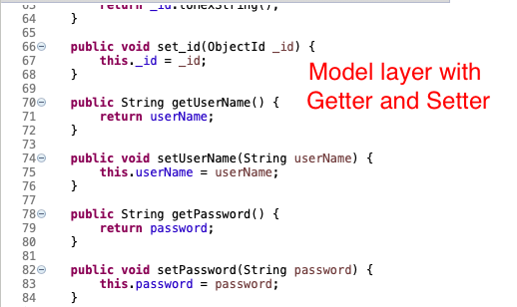
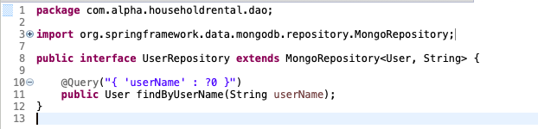
Model and Repository

Slide 8
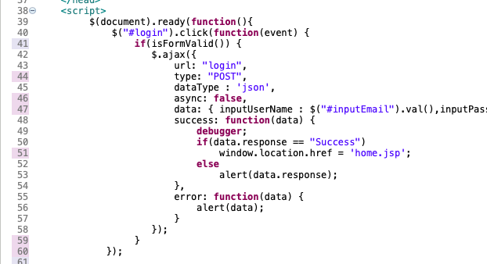
View - .JSP file

Slide 9
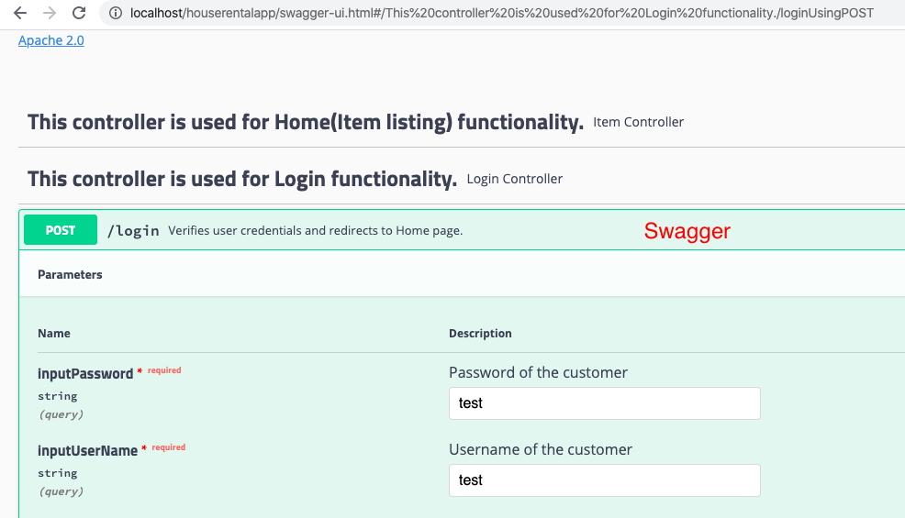
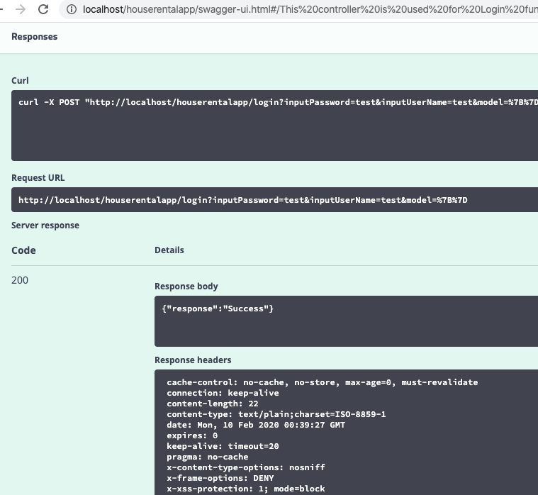
Swagger

Slide 10
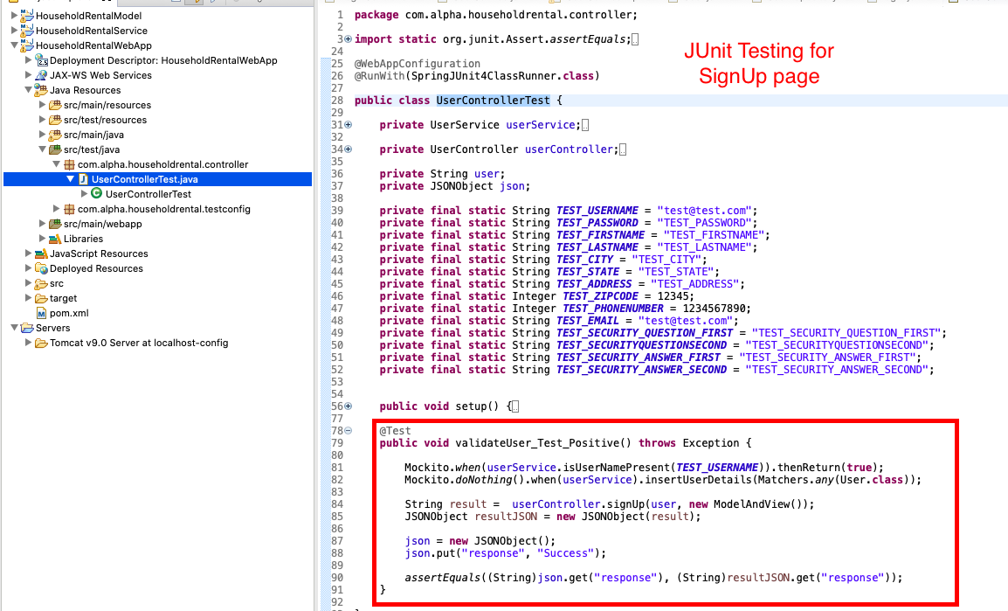
Junit – Unit Testing

Slide 11
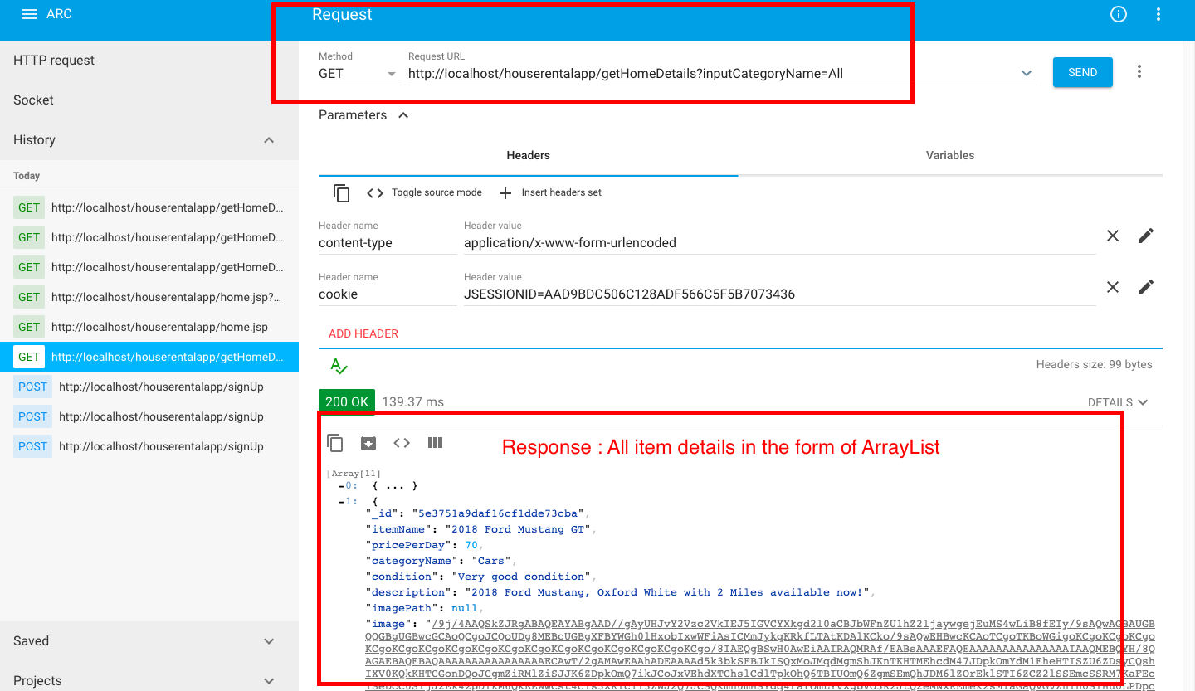
Request Response – Advanced Rest Client (ARC)

